Slide 1
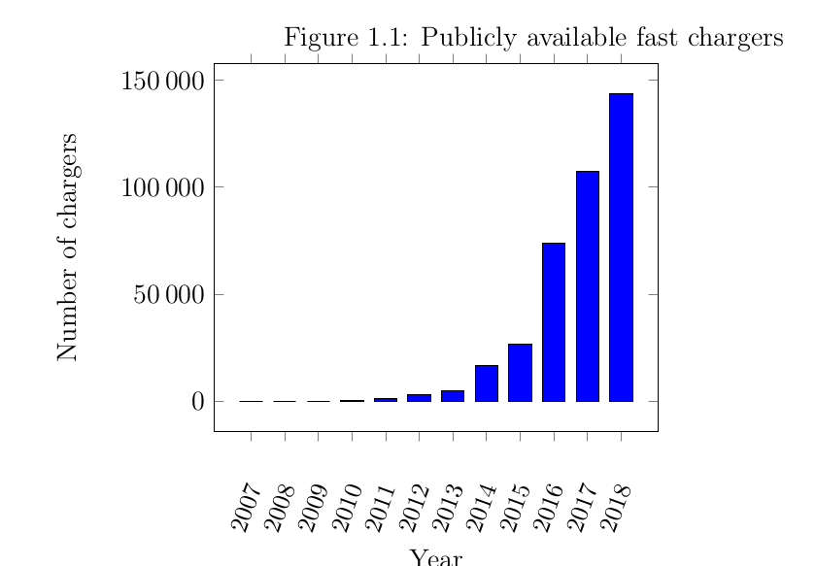
A VERIFIED OCPP v2.01 SERVER
Daniel McInnes & Assoc. Prof. Graeme Smith
A VERIFIED OCPP V2.01 SERVER FOR ELECTRIC VEHICLE NETWORKS
Open Charge Point Protocol
The number of publicly available electric vehicle fast charges is growing rapidly. Almost all of these chargers communicate with a server using “Open Charge PointProtocol” (OCPP). This protocol handles authentication, billing, electricity metering, smart charging and power limits.
Ideally,these servers should have no bugs and never crash. This can be formally verified if the following objectives are met:
SPARK 2014
Numerous verification tools were considered, before selecting SPARK 2014.
Using SPARK, all verification objectives were met, with the exception of ‘No stack overflows’. This feature is not available in the free “community edition” of the tool.
OCPP Subset
The OCPP protocol describes a large number of use cases, not all of which are necessary for a basic charging station. The goal of the project was to implement the following basic subset of the protocol.
 | Verification Objectives
1 | Functional Correctness
2 | No memory leaks
3 | All variables initialised before use.
4 | No runtime exceptions
5 | No stack overflows
6 | No hangs
7 | No undefined behaviour
8 | Constraint of information flow
 | Use Cases
1 | Booting
2 | Configuring
3 | Resetting
4 | Authorization
5 | Transactions
6 | Event monitoring
7 | Meter values
8 | Data Transfer
Code generation
A technique was developed to automatically generated SPARK code to serialise and deserialise (parse incoming text, and generate outgoing text) OCPP messages.
This is done by running a JavaScript utilty over the JSON protocol definition files, generating source files with SPARK postconditions.
Results
Not all of the use cases were implemented, only ‘Booting’ and ‘Configuring.
Possible future work includes extending the code generation utility to implement more of the use cases.
The SPARK language and verification tools were found to be a practical way to formally verify software.

